Slide 1
Initech Case Study

Slide 2
The problem
Company
Context
Problem statement
IniTech is a labor marketplace that matches employers with hourly workers for on-demand shifts. Employers post jobs, IniTech facilitates fulfillment, bills the employer, and pays the worker. The company earns “net take” on each job (which can vary based on take rate and any bonus paid to fill urgent shifts).
Operating since 2021, currently active across multiple U.S. markets.
Growth has been driven by expanding worker supply and increasing monthly revenue, but performance varies significantly by market.
Key questions for diligence are around worker retention, unit economics (LTV vs CAC), and whether the model improves or worsens as revenue scales (operating leverage vs loss-amplifying growth).
IniTech is growing revenue, but it’s unclear whether growth is profitable and scalable. We need to assess worker retention, LTV vs CAC, and whether costs rise faster than revenue as the company expands.

Slide 3
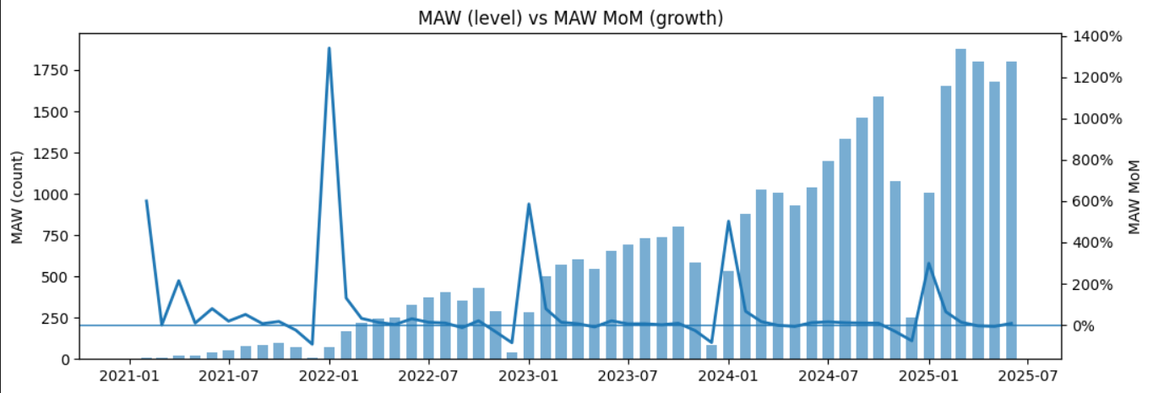
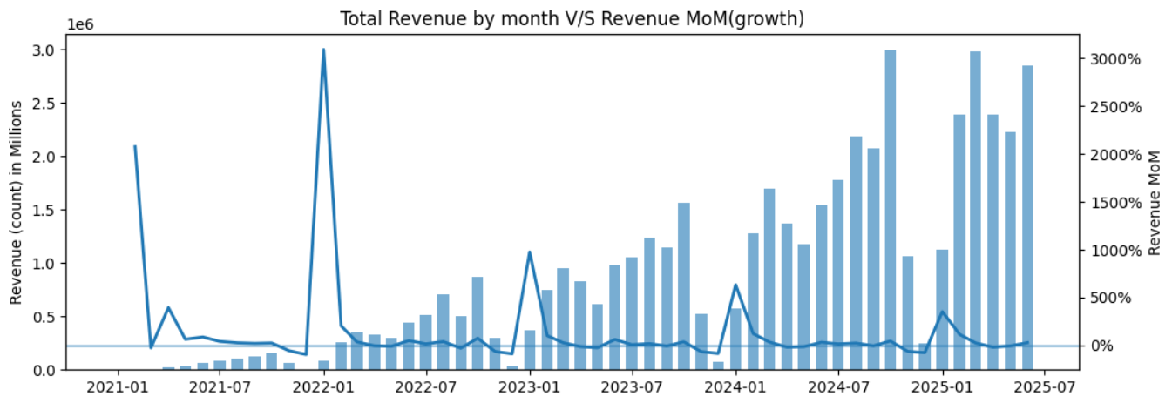
Workers and Revenue Growth
Clear scale-up (2021 → 2025): Monthly Active Workers (MAW) grow from very low levels to roughly ~1.7–1.9k by 2025, showing the platform has expanded its active supply base.
Revenue ramps with scale: Monthly revenue climbs materially and reaches about ~$2–3M/month in 2024–2025, suggesting the business is generating meaningful volume as it grows.
Growth is “bursty,” not steady: MoM growth shows big spikes, followed by normalization, which looks more like step-changes from holiday season/market expansions than smooth compounding.
Early MoM spikes are inflated by small base: In the early period, MAW/revenue are small, so even modest absolute increases show up as very large % changes (small-denominator effect).
Supply + demand seem to be scaling together: Since MAW and revenue increase in the same direction overall, it suggests IniTech is adding workers while still finding enough demand to keep them active, though the MoM volatility implies momentum may rely on episodic pushes rather than consistent growth.

Slide 4
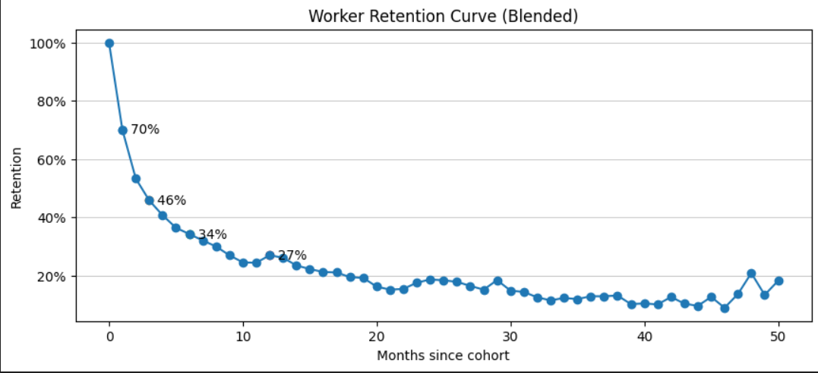
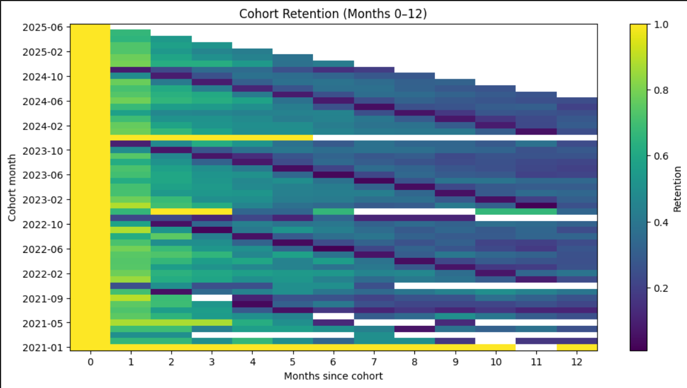
Cohort Retention
Retention drops fast early on (high churn): The blended curve falls from 100% at month 0 to about ~70% by month 1, then to roughly ~46% by month 3 and ~34% around month 6. This suggests a lot of workers try the platform but don’t become repeat/consistent users in the first few months.
There’s still a long-tail “core” of workers: After the first ~6–12 months, retention flattens and generally sits in the ~10–20% range for older worker ages. That implies a smaller group of workers keeps coming back and likely drives a meaningful portion of ongoing volume.
Cohort heatmap supports the same story: Most cohorts show the expected diagonal fade (retention decreasing as months_since_cohort increases), with some cohort-to-cohort variation. The blank cells toward the far right are mostly right-censoring (newer cohorts haven’t existed long enough to observe later-month retention).
What it means for the business: The biggest opportunity is improving early retention (month 1–3), that’s where the largest drop happens, so even small improvements there should meaningfully increase worker LTV(Lifetime Value) and reduce reliance on constantly acquiring new workers.
Blank spaces = cohort not old enough yet

Slide 5
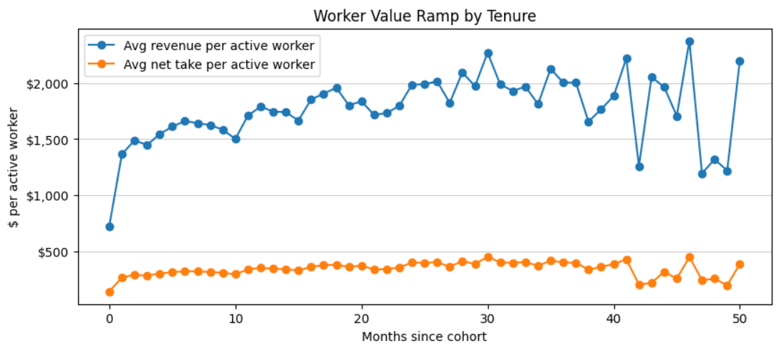
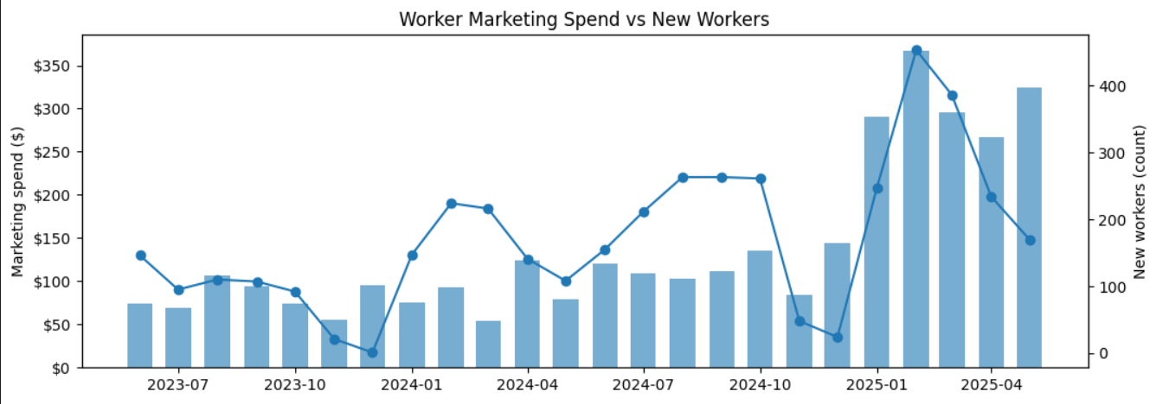
Worker’s Value and CAC
Worker value ramps with tenure: The worker value chart suggests that as workers stay longer, they become more productive. Avg revenue per active worker stabilizes around ~$1.5k–$2.2k, and avg net take per active worker generally sits around ~$250–$450, meaning retained workers generate more consistent value for the platform.
Blended LTV is meaningful by 12 months: Combining retention + value ramp, the blended estimates are about LTV6 (net take) ≈ $840 and LTV12 (net take) ≈ $1,381. For volume context, LTV6 revenue ≈ $4,350 and LTV12 revenue ≈ $7,145.
Acquisition efficiency looks inconsistent month-to-month: The marketing spend vs new workers chart shows that increases in spend don’t always translate into proportional new worker growth, which points to CAC volatility (channel mix / seasonality / diminishing returns).
What they can pay to acquire a worker: Median worker CAC is roughly ~$792. That puts LTV6/CAC ≈ 1.06 (near break-even by ~6 months on net take) and LTV12/CAC ≈ 1.74 (better by 12 months). Using a more conservative gross-profit proxy, gmLTV6/CAC ≈ 0.86 and gmLTV12/CAC ≈ 1.42, so payback is stronger over a 12-month view than a 6-month view.
Blank spaces = cohort not old enough yet

Slide 6
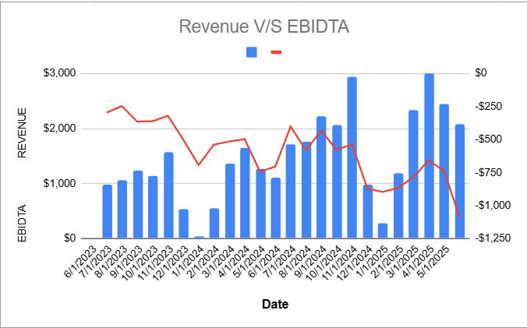
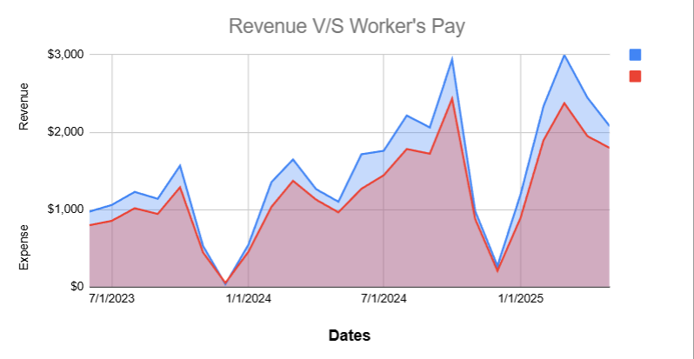
What’s interesting if they scale?
As IniTech scales, the most interesting (and risky) dynamic is that growth currently looks loss-amplifying: higher revenue months line up with more negative EBITDA, likely because revenue scales closely with worker pay (a large pass-through cost) and the company hasn’t shown operating leverage yet. With CAC (median) ≈ $792 and LTV6/LTV12 (net take) ≈ $840/$1,381 (so LTV6/CAC ≈ 1.06 and LTV12/CAC ≈ 1.74), the model can pay back over ~12 months, but the buffer isn’t huge, so at scale it will be important to see whether they can increase take rate/net take per job and lower overhead per job to shift from “revenue up → losses up” toward break-even/positive EBITDA.
The key question is whether they can flip the trend to EBITDA break-even/positive by improving early retention and net take. Using the worker-side metrics we computed, the business does have a base to build on: retention forms a long-tail core and worker value ramps with tenure, which supports LTV6 / LTV12 improving as workers stay longer. A practical approach is to pilot improvements first in high-LTV, high-volume markets (e.g., LA, SF Bay, NYC/DC) and then roll out broadly if unit economics and EBITDA trajectory improve.
Blank spaces = cohort not old enough yet

Slide 7
Key Findings
Challenge 1
Challenge 2
Challenge 3
Challenge 4
Worker Retention
Key finding: Retention drops sharply early (big churn in months 1–3), then stabilizes into a smaller long-tail core of repeat workers.
Acquisition Efficiency
Key finding: Worker marketing spend doesn’t translate into steady new-worker growth every month → CAC is volatile and acquisition looks inconsistent.
Unit economics
Key finding: Unit economics improve with tenure (worker value ramps). Blended LTV6 ≈ $840 and LTV12 ≈ $1,381 vs CAC ≈ $792 → payback is stronger by ~12 months than 6 months.
Scaling profitability
Key finding: Revenue growth is currently loss-amplifying: higher revenue aligns with more negative EBITDA, driven largely by worker pay scaling with revenue. The scaling question is whether they can break even by improving take rate/efficiency and retention.

Slide 8
THANK YOU! :)

